Slide 1
Apple finance analysis

Slide 2
This analysis examines Apple inc's financial performance over 15 years using key metrics to inform company strategies. The data is presented through bar graphs for easy visualization enabling stakeholders to make informed decisions about future investments and operational strategies.
Data cleaning and preparation were conducted as needed ensuring accurate and impactful visualizations with tools like matplotlib and seaborn allowing users to derive meaning insights effortlessly.
Key financial trends are highlighted to showcase Apple’s growth and resilience offering a clear narrative that supports strategic planning and investment insights.
Comparative analyses across key years emphasize critical milestone and shifts in performance providing a comprehensive understanding of the company’s growth trajectory.

Slide 3
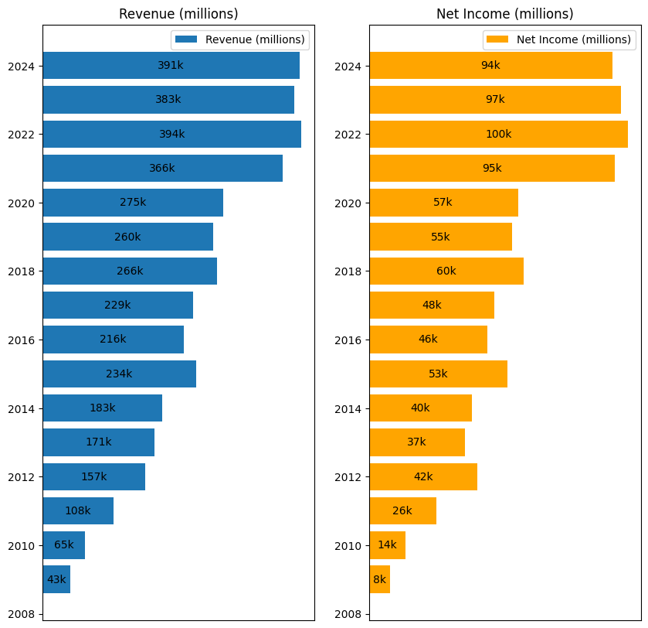
Revenue and Net Income
Insights:
Bar graph showing yearly Revenue and Net income.
Over the past four years, Apple has demonstrated significant revenue growth and achieved strong net income levels. This indicates successful strategic initiatives and operational efficiency.

Slide 4
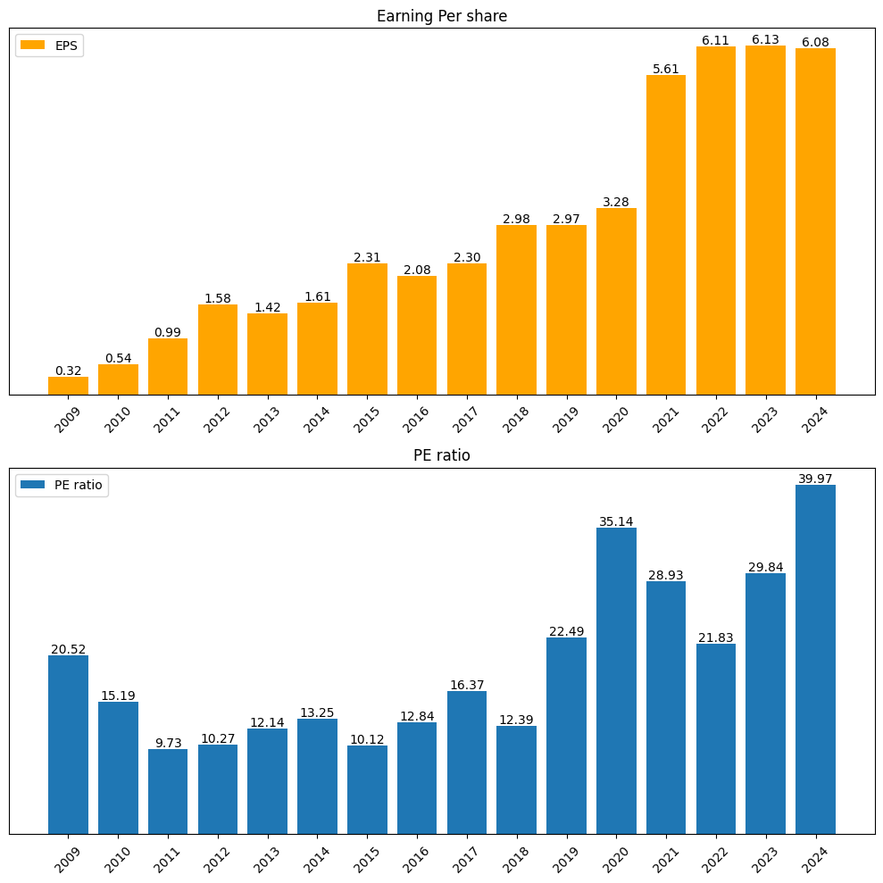
Earning per share & PE ratio
Insights:
Bar graph showing last 15 year Earing per share and PE ratio.
In the last four years, EPS has shown consistent improvement. The P/E Ratio peaked in 2020 and 2024, likely reflecting increased investor demand for Apple shares during those years.

Slide 5
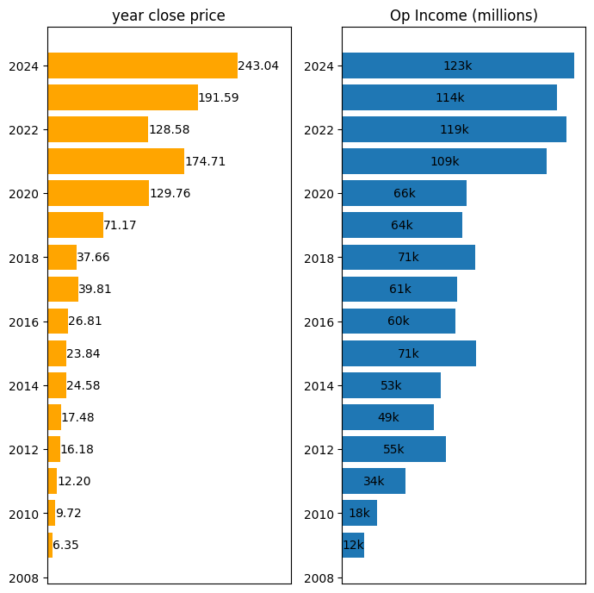
Close price & Operational Income
Insights:
Bar graph showing last fifteen years close price and operational income.
The last two years have seen record-high close prices, though operational expenses have risen significantly. This trend highlights the need for cost management to sustain profitability.

Slide 6
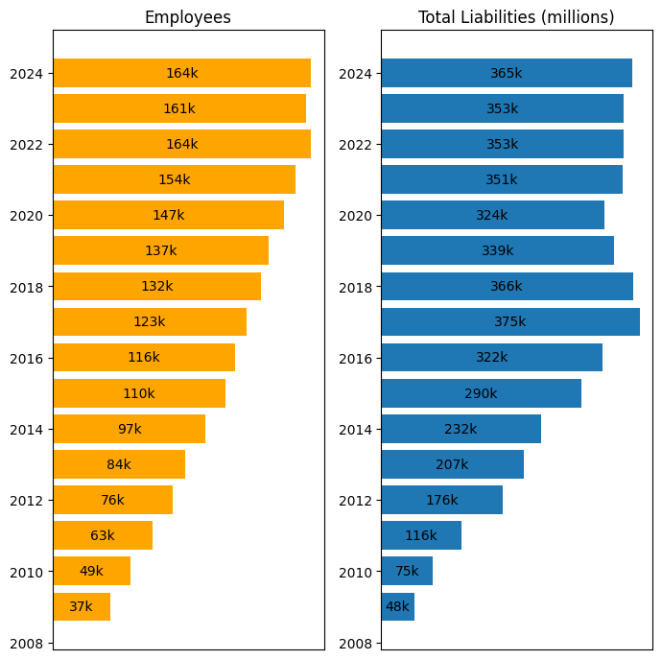
Employee Count and Total Liabilities
insights:
Bar graph showing no of employee working in apple and Liabilities of apple.
Over the last seven years, liabilities and employee numbers have both grown. To optimize costs, the company could consider workforce efficiency improvements by identifying and addressing areas with excess or underperforming staff.

Slide 7
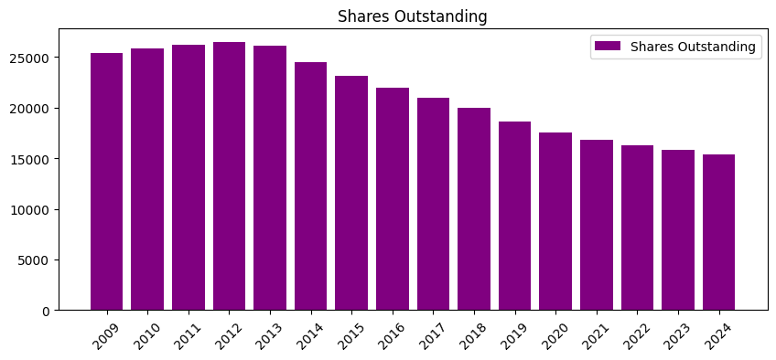
Shares Outstanding by Year
Insights:
Bar graph showing shares of apple in every year.
Apple has steadily increased shares outstanding year-over-year to capitalize on market conditions and raise funds for growth.

Slide 8
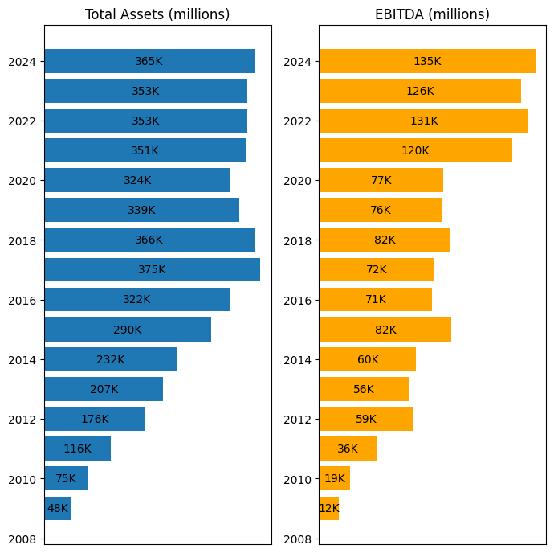
Total Assets & EBITDA
Insights:
Bar graph showing Assets of apple and EBITDA of apple.
Over the last four years, EBITDA has grown significantly, reflecting improved profitability. Total Assets have consistently increased, demonstrating Apple’s ability to invest in long-term growth.

Slide 9
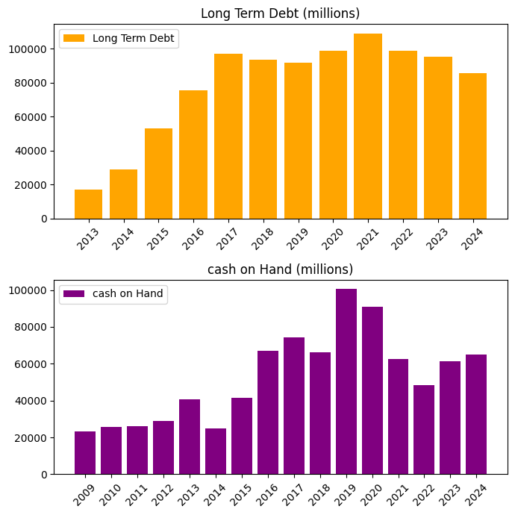
Long-Term Debt & Cash on Hand
Insights:
Bar graph showing apple Long term dept and cash of hand
From 2016 to 2024, Apple maintained a stable long-term debt while significantly increasing cash reserves, demonstrating financial stability and liquidity.

Slide 10
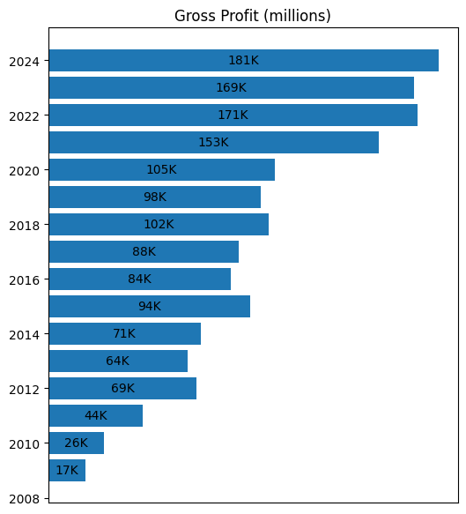
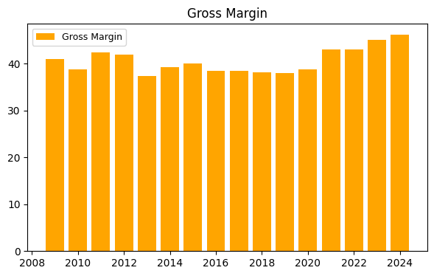
Gross Profit & Gross Margin
Bar graph showing Gross profit and gross margin of apple
Insights: Gross profit has risen sharply over the past four years, but gross margin percentages have remained relatively stable, suggesting consistent cost management relative to revenue.

Slide 11
Conclusion & Recommendations
Revenue and net income growth are strong, indicating solid financial performance.
Operational cost need careful monitoring and sustain high closes prices and profitability.
Workforce efficiency could be improved to reduce liabilities
Focus Areas:
Maintain EPS growth while managing P/E ratio during investor demand peaks.
Optimize operational spending to balance growth and profitability.
Feedback:
Please review the visualization and provide suggestions for additional metrics or refinements. Are there specific areas you would like more detailed analysis on?

Slide 12
Thank you

